Slide 1
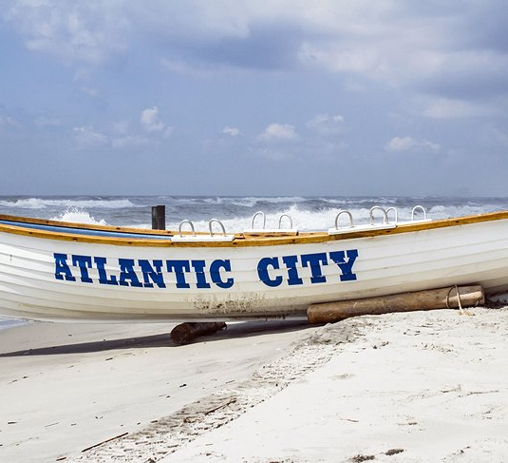
Atlantic City

Slide 2
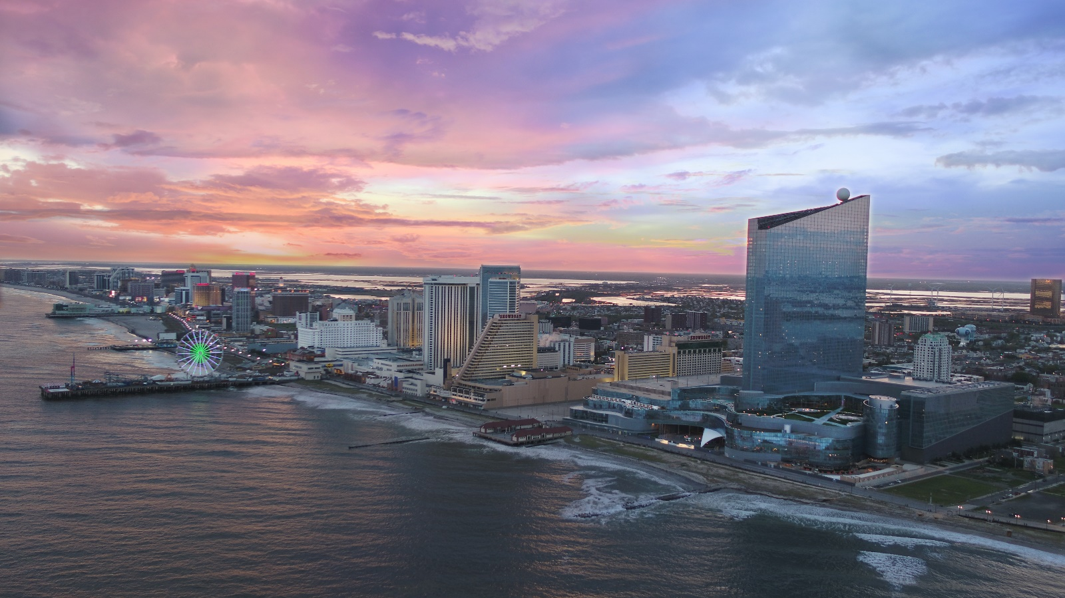
ATLANTIC CITY - #STRONGERTOGETHER

Slide 3
Hopefully the following presentation will inspire you to consider Atlantic City as a future destination

Slide 4
Atlantic city #strongertogether

Slide 5
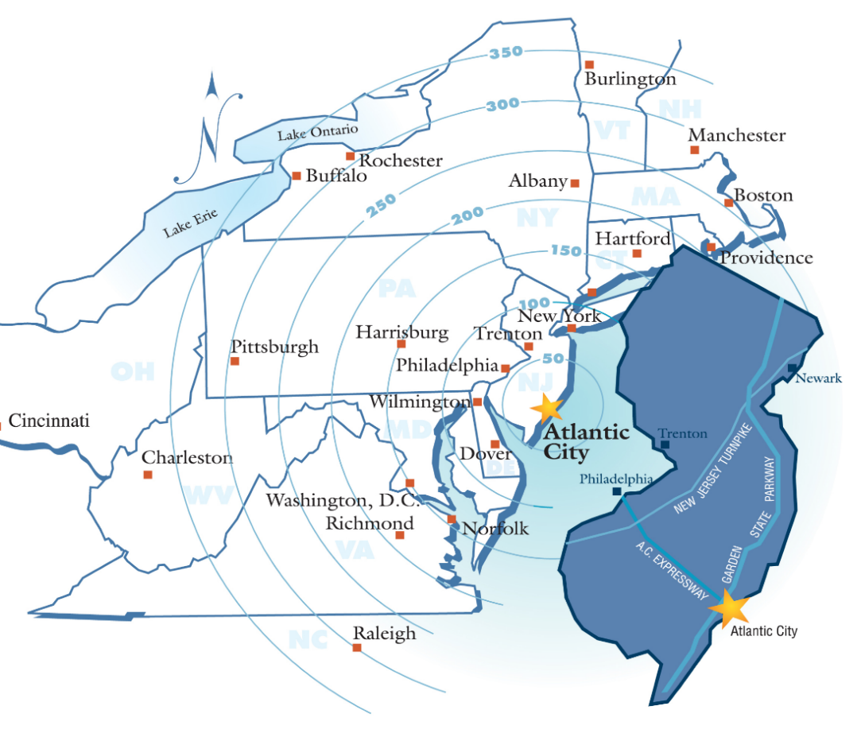
Atlantic City
Location, location, location
2 hours from New York City
60 minutes from Philadelphia
3 ½ hours from Washington, DC

Slide 6
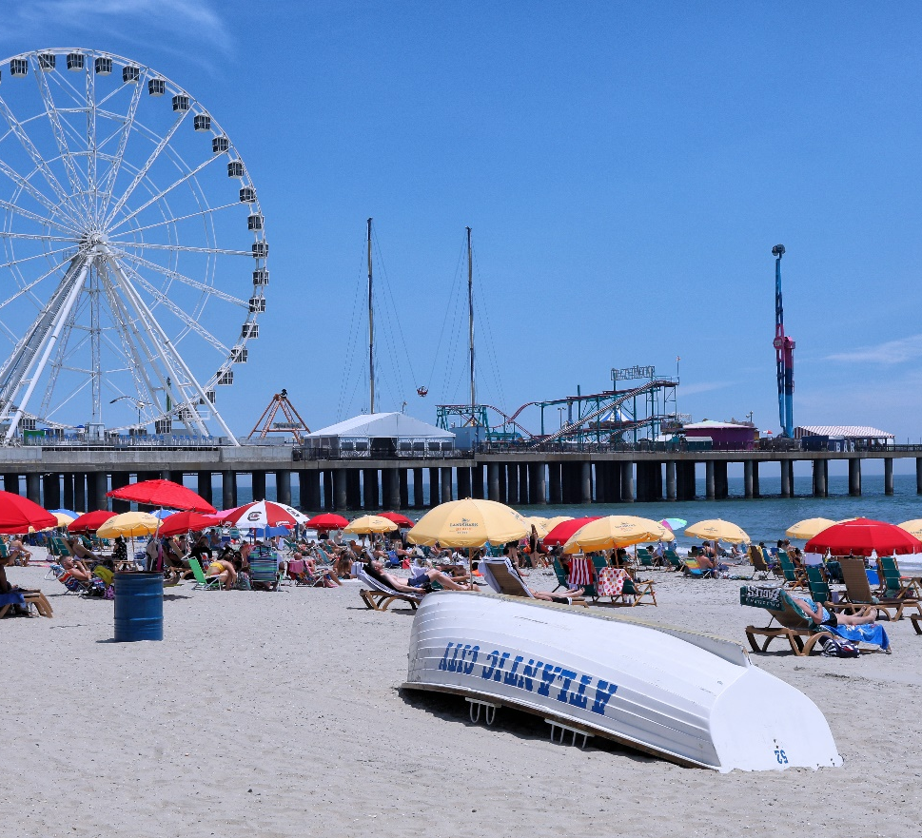
Atlantic City - Facts
Centrally located on the East Coast
Easy access by train and car
America’s first Boardwalk
Golfers paradise with 22 golf courses
7 miles of free white sandy beaches
18,000 hotel rooms with brands that you know
9 world-class casino resorts
Largest gaming destination on the East Coast

Slide 7
Atlantic city Video

Slide 8
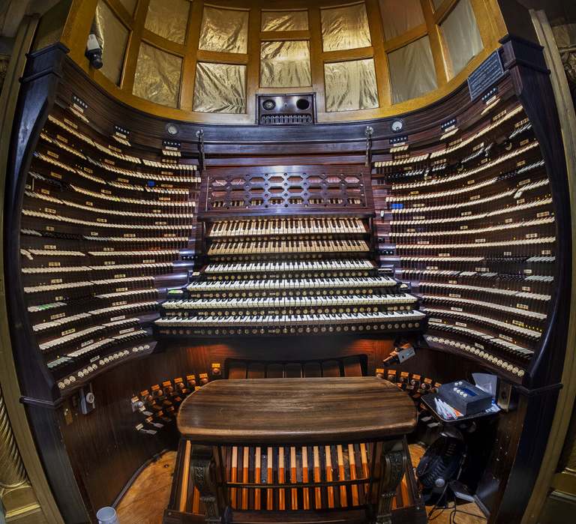
Jim Whelan Boardwalk Hall
Built in 1929
Formerly known as Convention Hall
14,000 seated arena offering world-class performances
Adrian Phillips Theater
Home to the world’s largest musical instrument and oldest working pipe organ the Midmer-Losh
Free 30-minute concerts and tours May – Sept at 12.00pm

Slide 9
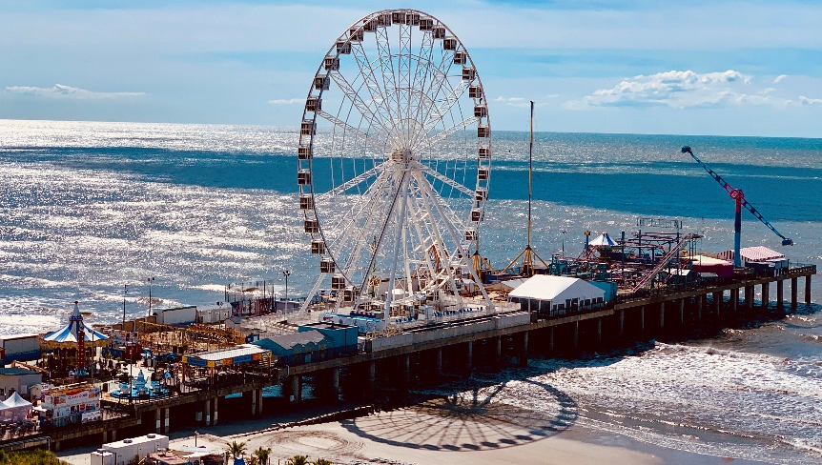
Recreation
Historic Steel Pier Amusement Park
Historic Absecon Lighthouse

Slide 10
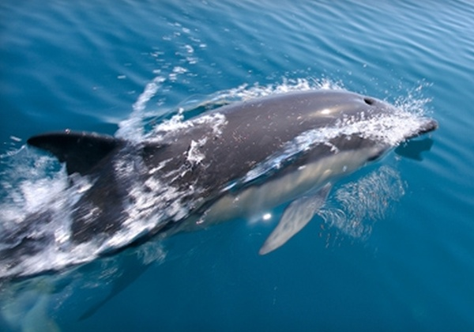
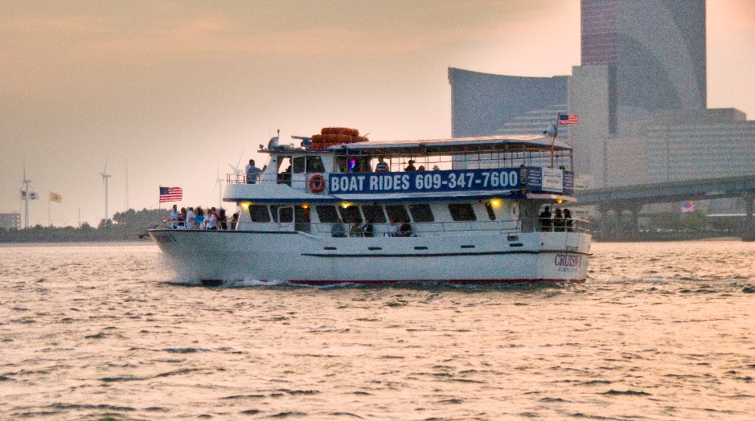
Recreation
Historic Gardner’s Basin
Atlantic City Aquarium
Atlantic City Cruises
Boating and Fishing
Parasailing
Dolphin Watching

Slide 11
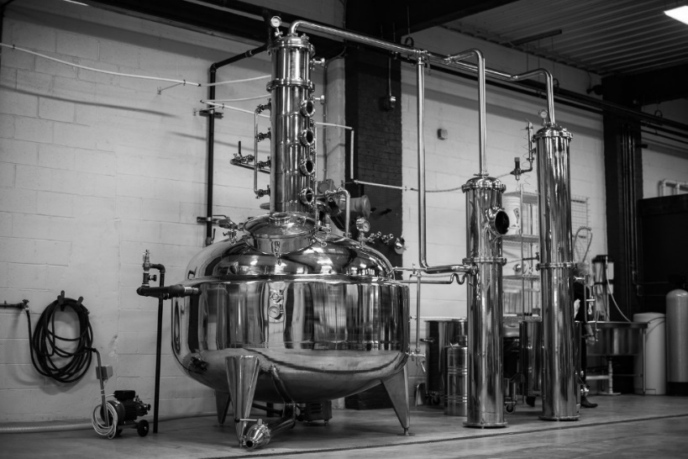
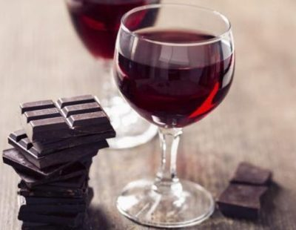
Recreation
Wine and Ale Trails – over 20 wineries and breweries
Atlantic City Foodie Tour
Little Water Distillery

Slide 12
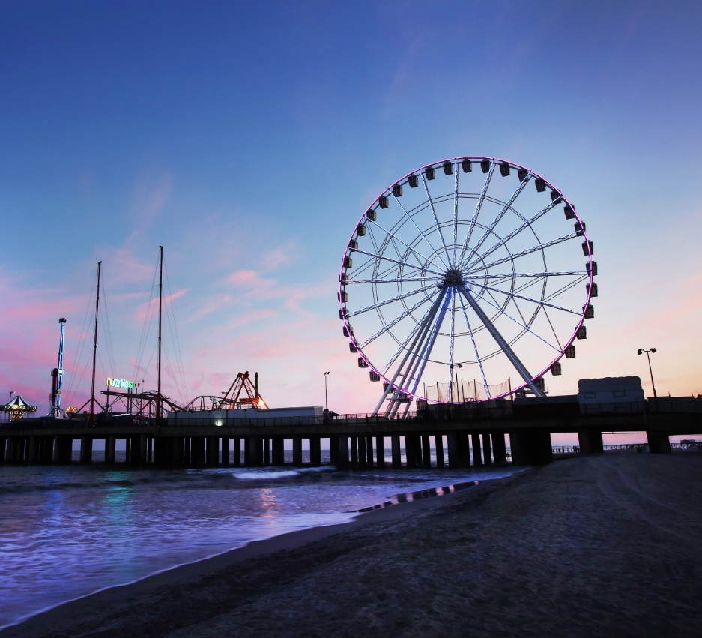
Steel Pier Observation Wheel
Third largest wheel in the United States
227 Feet Tall
40 Temperature controlled gondolas
Each gondola holds up to 6 people

Slide 13
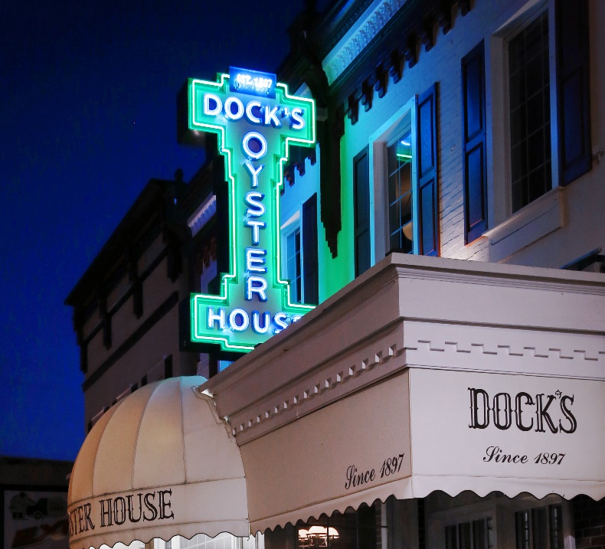
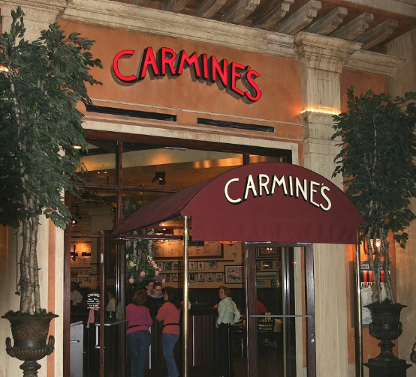
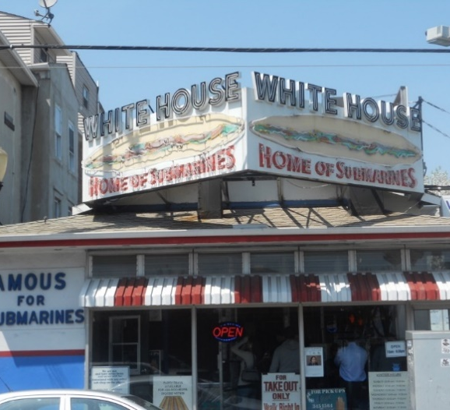
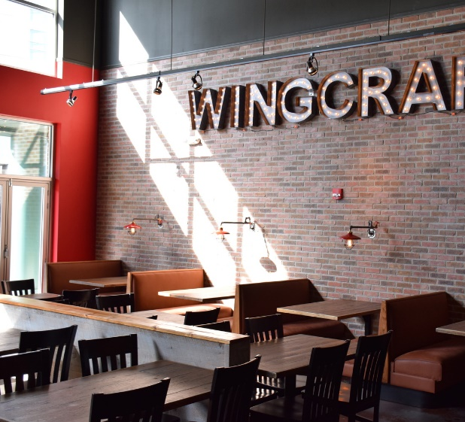
From Local to Famous food…

Slide 14
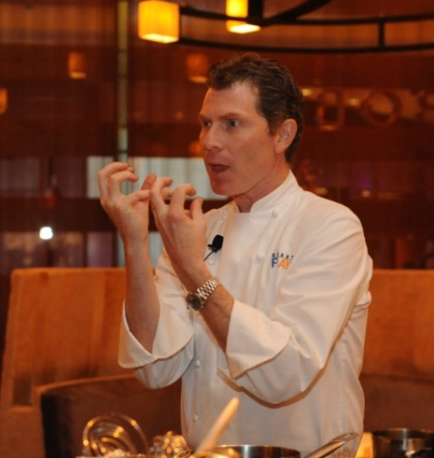
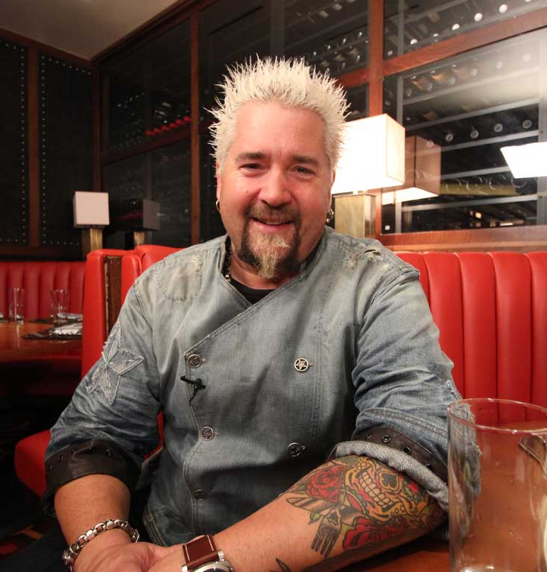
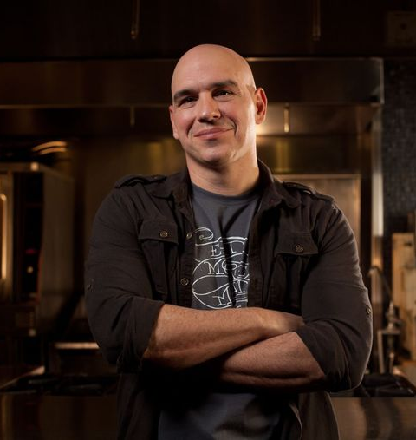
And World Class Dining And Celebrity
Acclaimed Chefs!
Bobby Flay Steak
Guy Fieri’s Chophouse
Angeline by Michael Syman
Gordon Ramsay Pub & Grill

Slide 15
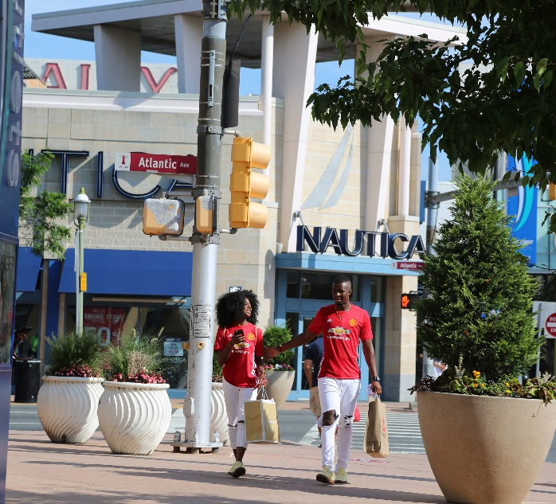
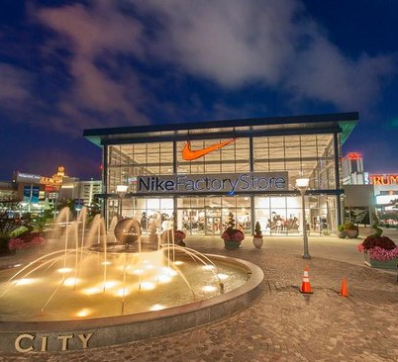
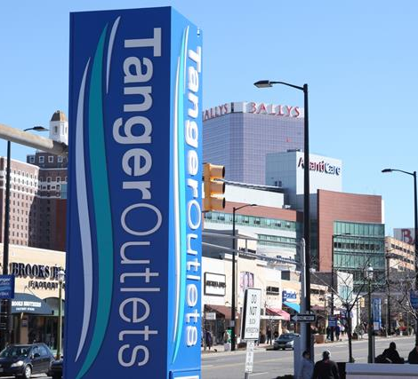
TaNGER OUTLET THE WALK
Tax Free Shopping
Over 100 Retail Stores
Nike, Michael Kors, Coach, Kate Spade, Polo Ralp Lauren
International Visitors receive complimentary coupon booking offering further discounts
Walking distance from hotel and the Boardwalk

Slide 16
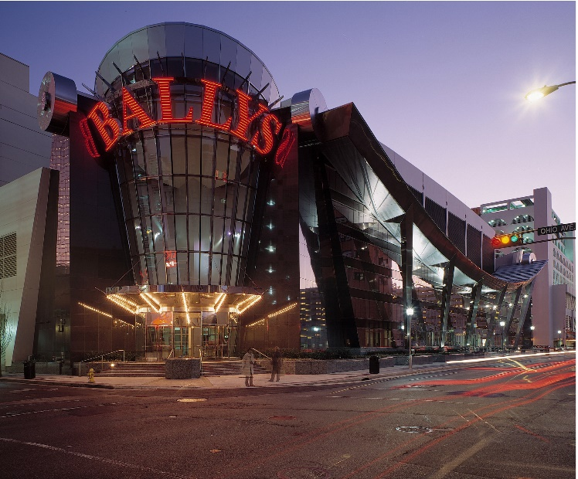
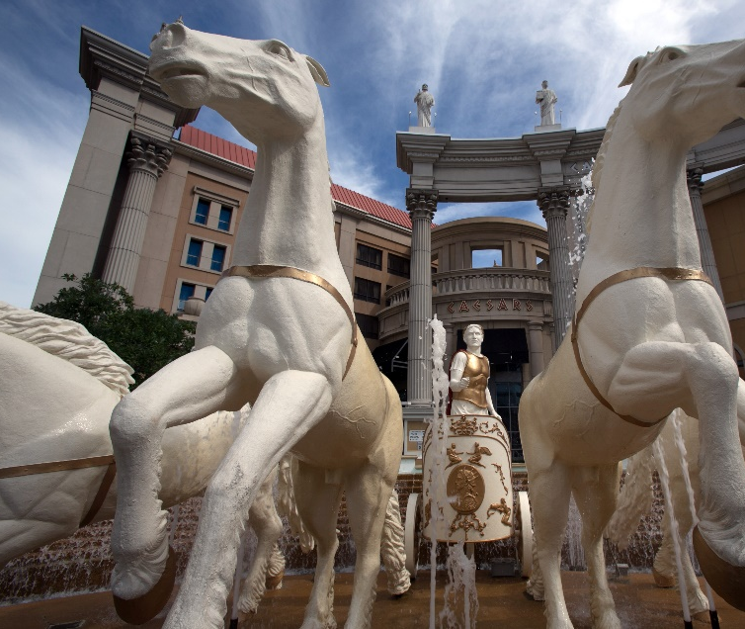
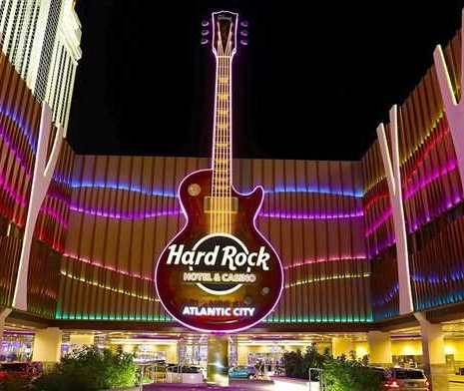
Casino Resorts on the Boardwalk
Bally’s Atlantic City
Caesars Atlantic City
Hard Rock Hotel & Casino

Slide 17
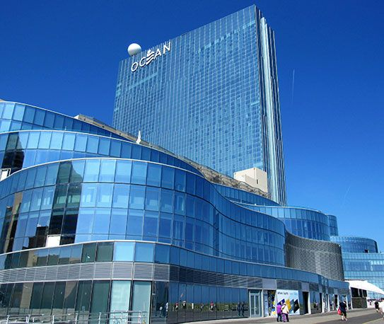
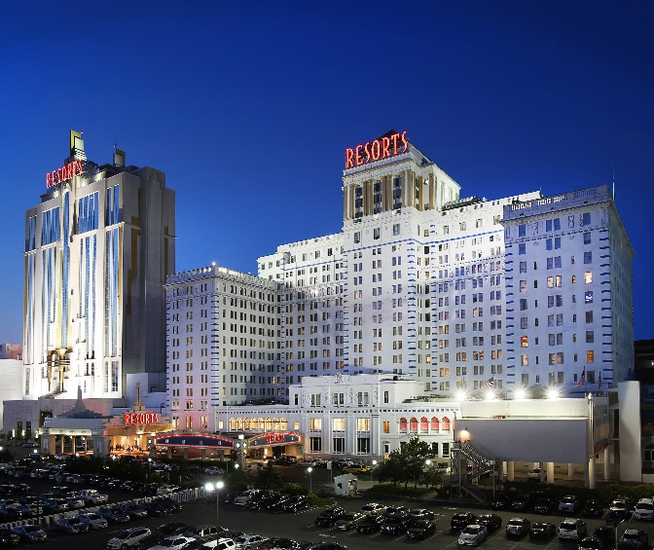
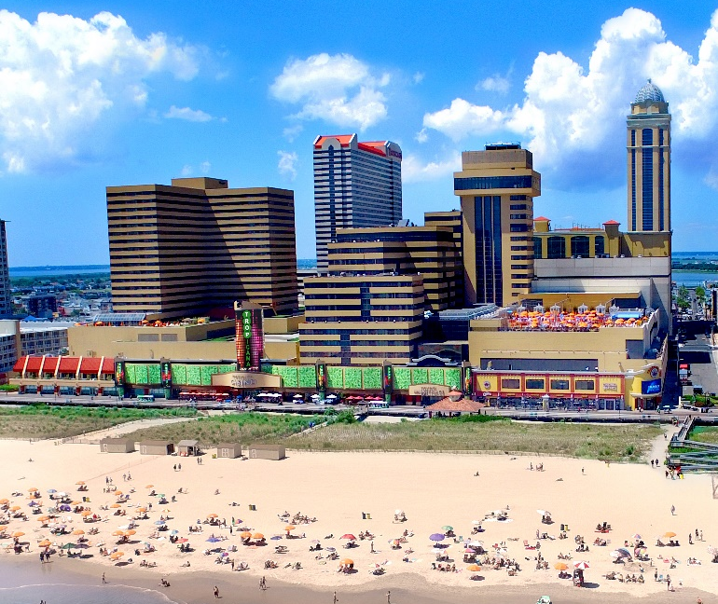
Casino Resorts on the Boardwalk
Ocean Resort & Casino
Resorts Casino Hotel
Tropicana Resort & Casino

Slide 18
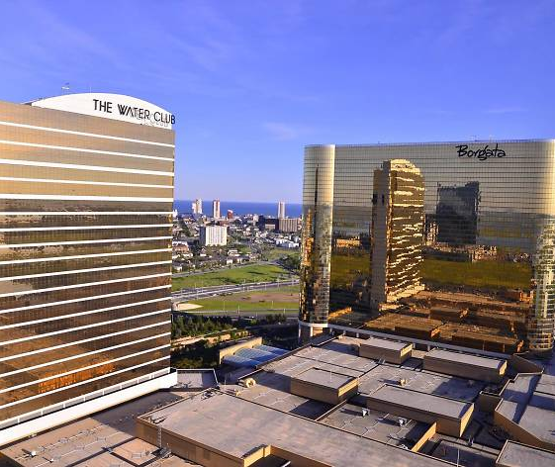
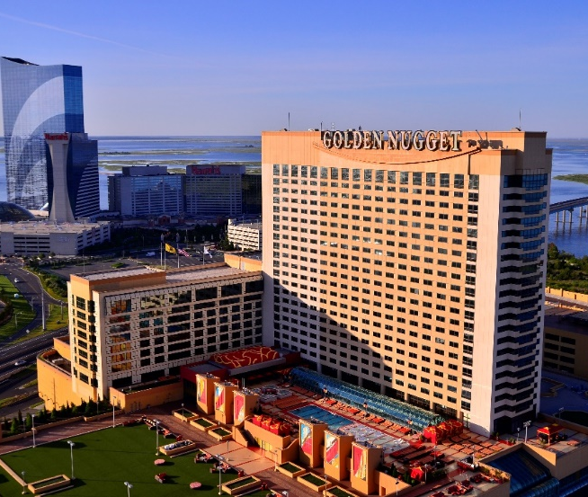
Casino Resorts on the Marina
Borgata Hotel & Spa and The Water Club
Harrah’s Resort & Casino
Golden Nugget Atlantic City

Slide 19
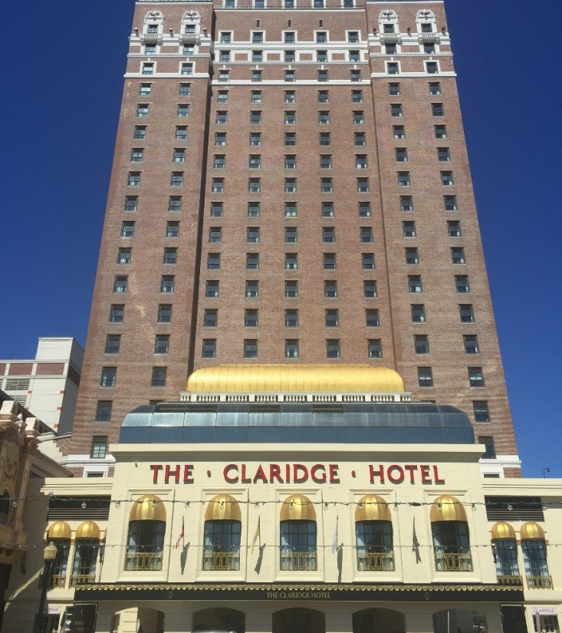
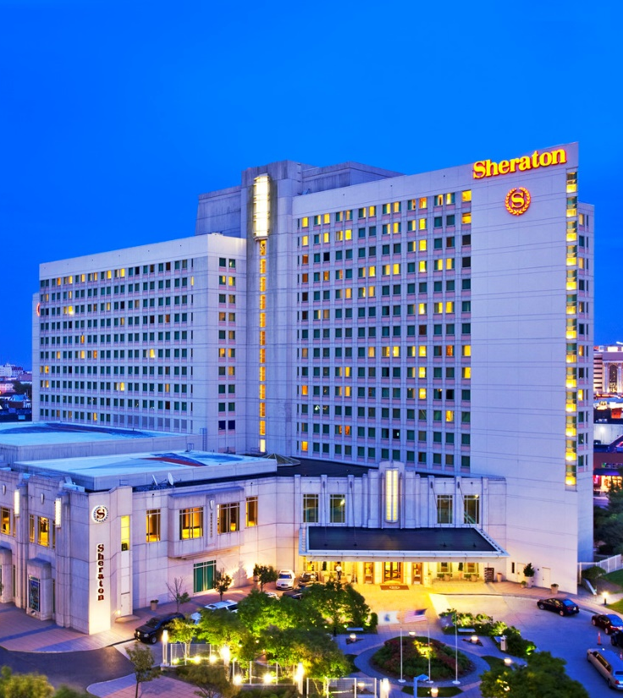
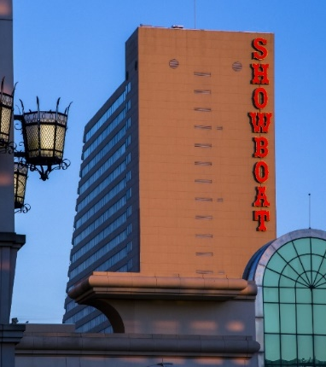
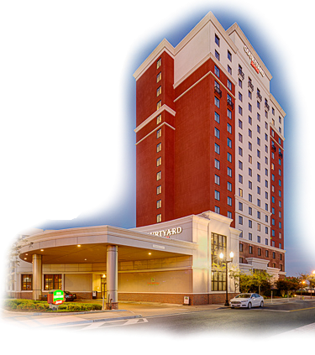
Other Hotels
Courtyard by Marriott
The Claridge Hotel
The Sheraton Hotel
Showboat Atlantic City

Slide 20
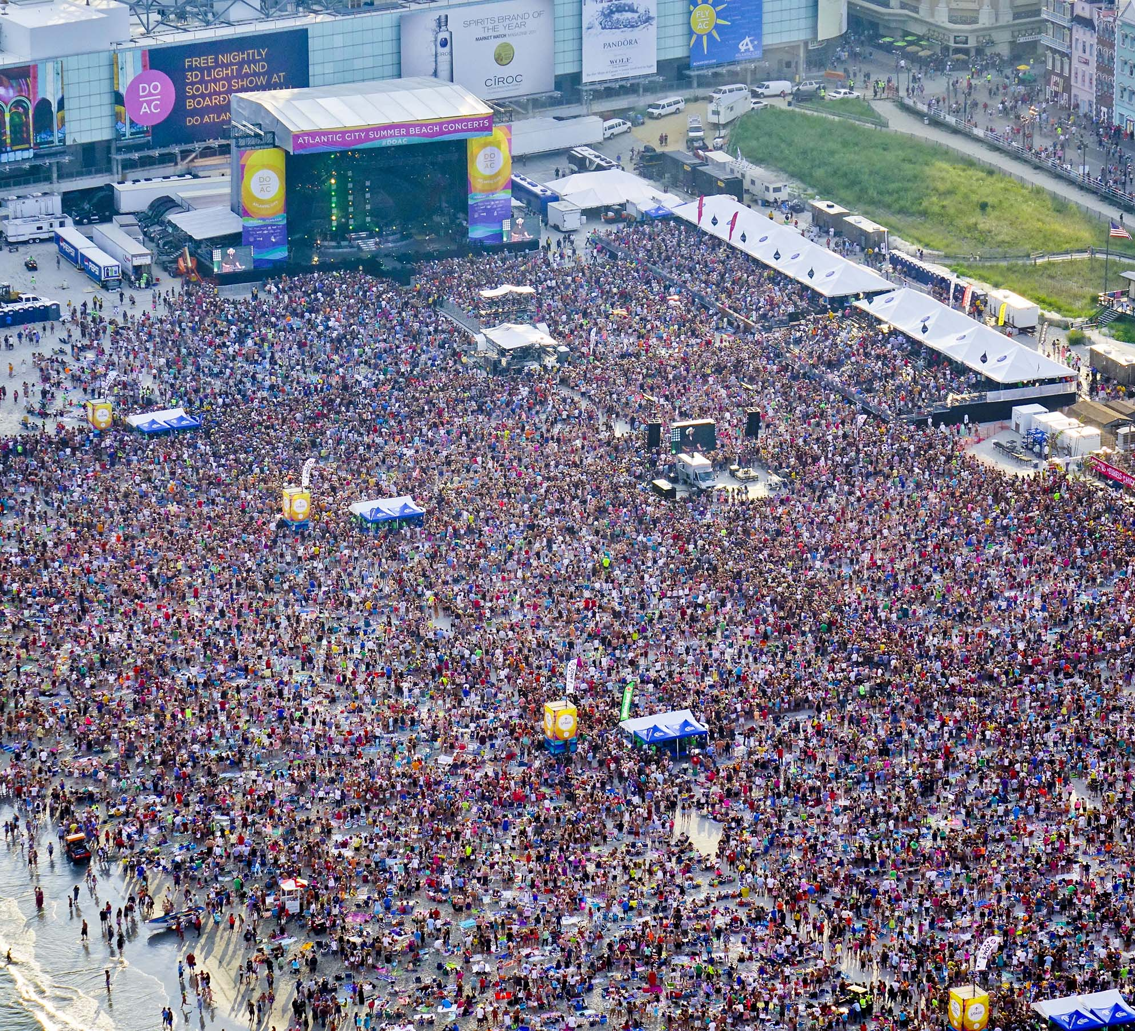
Atlantic City entertainment capital of the jersey shore!

Slide 21
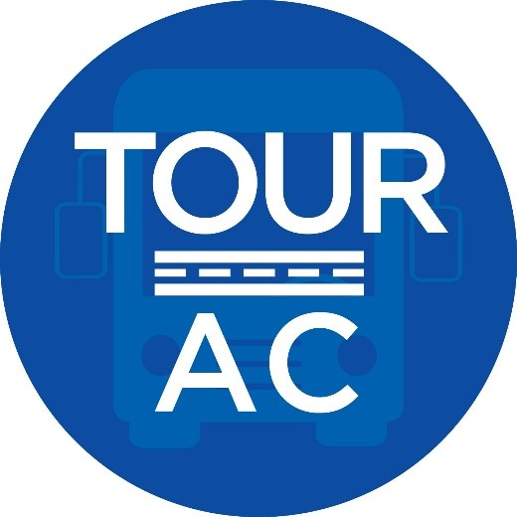
Thank You
FOR MORE INFORMATION VISIT
WWW.ATLANTICCITYNJ.COM
OR CONTACT GEC TR ON
info@gregevansconsultancy.com

